Slide 1
Juliette Gordon Low Created Modern ‘Girl-Power’

Slide 2
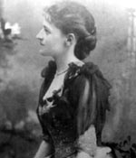
Juliette Gordon Low created the Girl Scouts to empower young women and girls to become everything they want to be, regardless of what others said.

Slide 3
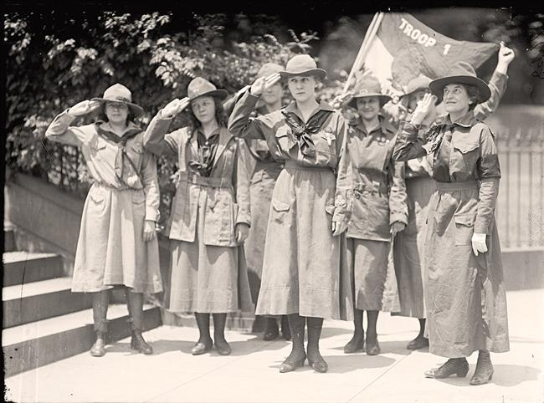
The first Girl Scout troop did a wide variety of activities, from cooking and sewing, to basketball and hiking, and provided opportunities for girls to discover themselves.

Slide 4
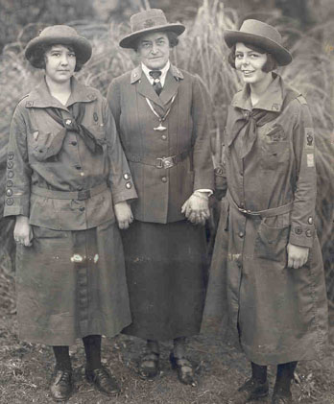
Troop One even went on a camping trip, a traditionally strictly “boys only” activity.

Slide 5
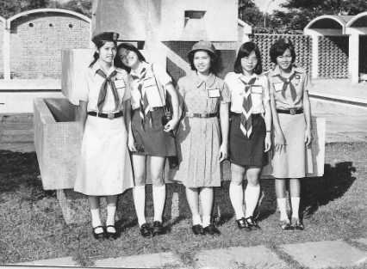
Juliette Low’s Girl Scouts have spread all over the United States and provides an inclusive and supportive environment for every Girl Scout

Slide 6
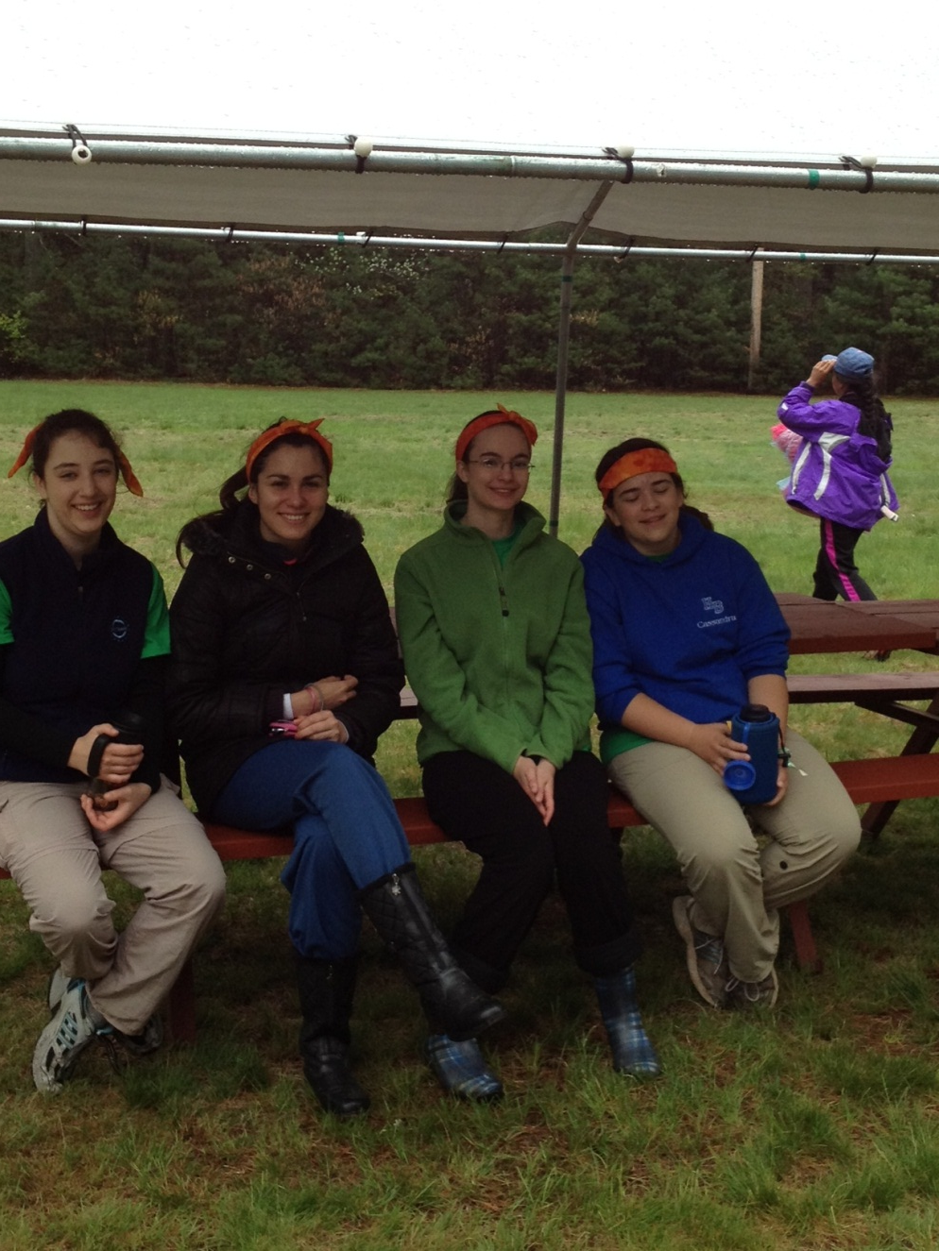
Girl Scouts now learn everything from marketing to arts and crafts to outdoorsman skills. Girls now can do anything boys can and Juliette Low helped inspire that change from the 1900’s.

